Slide 1
Kupu Pathways & Continuing Professional Education
In Partnership with Arizona State University
EdPlus

Slide 2
Overview
What is Kupu Pathways? Who is it for?
Steps to register and earn credit
Costs
FAQ
What is Continuing Professional Education? Who is it for?
Contact info & important links
Questions
EdPlus

Slide 3

What is Kupu Pathways? Who is it for?
Partnership with ASU’s Earned Admissions Program since April 2020
Quick and simple, financial affordable way to earn college credit OR sit in on a class of interest for free without earning credit
Open to current Kupu program participants, Kupu alum and staff
For anyone wanting to make progress towards a Bachelor’s degree
Whether you need a fresh start or a jump start, Kupu Pathways is your answer.
EdPlus
Notes:
In April, Kupu announced Kupu Pathways- an initiative created in partnership with Arizona State University and their Earned Admissions program.
I do want to point out that Arizona State University has different partners through their Earned Admissions like Kupu, however each partnership looks a little different making Kupu Pathways unique to Kupu. I say that because as we walk through the process of registering, while you may see “Earned Admissions” in some of the screenshots, your user experience will be Kupu Pathways specific.
Kupu Pathways offers participants a clear track into higher education, no matter your financial status or past academic performances
While most Universities require you to undergo lengthy application processes, Kupu Pathways offers a quick and simple alternative. This initiative does not require a certain grade point average for admission. Instead, once you are selected to participate in a Kupu program, or have completed a Kupu program, you are automatically eligible to take the courses offered that you want and in your own time.

Slide 4
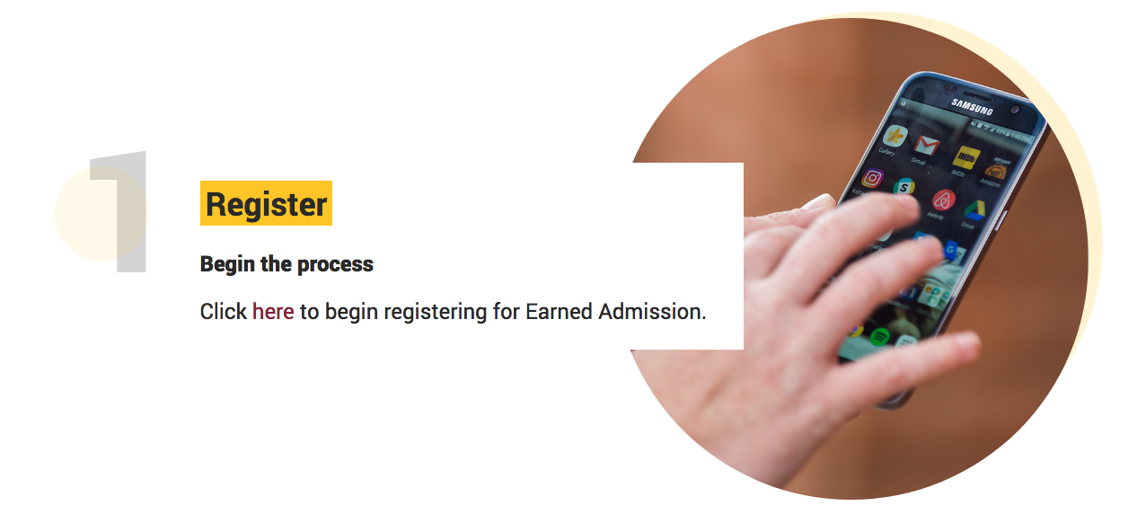


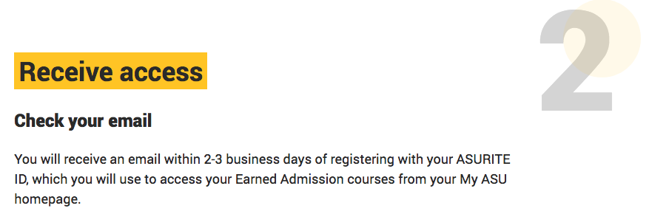


Register at kupu.ea.asu.edu
Obtain an ASURITE ID within 2-3 days
Log-in to choose courses and click on “Upgrade” ($25 per course attempt)
Obtain college credit if satisfactory grade is received ($400 per course) by clicking on “Add to Transcript” after completing your course.
EdPlus

Slide 5
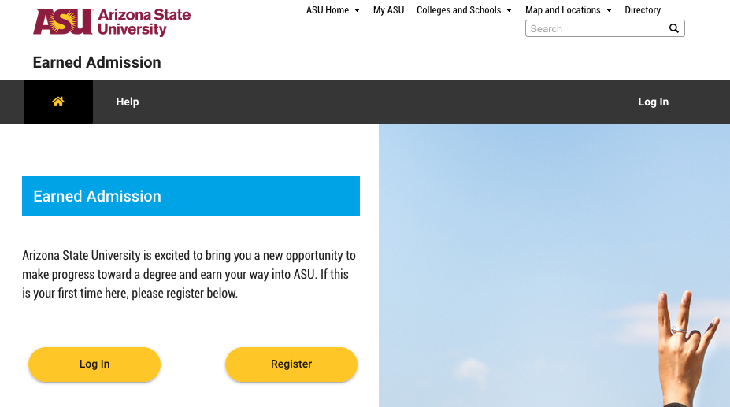
Kupu Pathways Web Application
GENERAL
kupu.ea.asu.edu
EdPlus

Slide 6
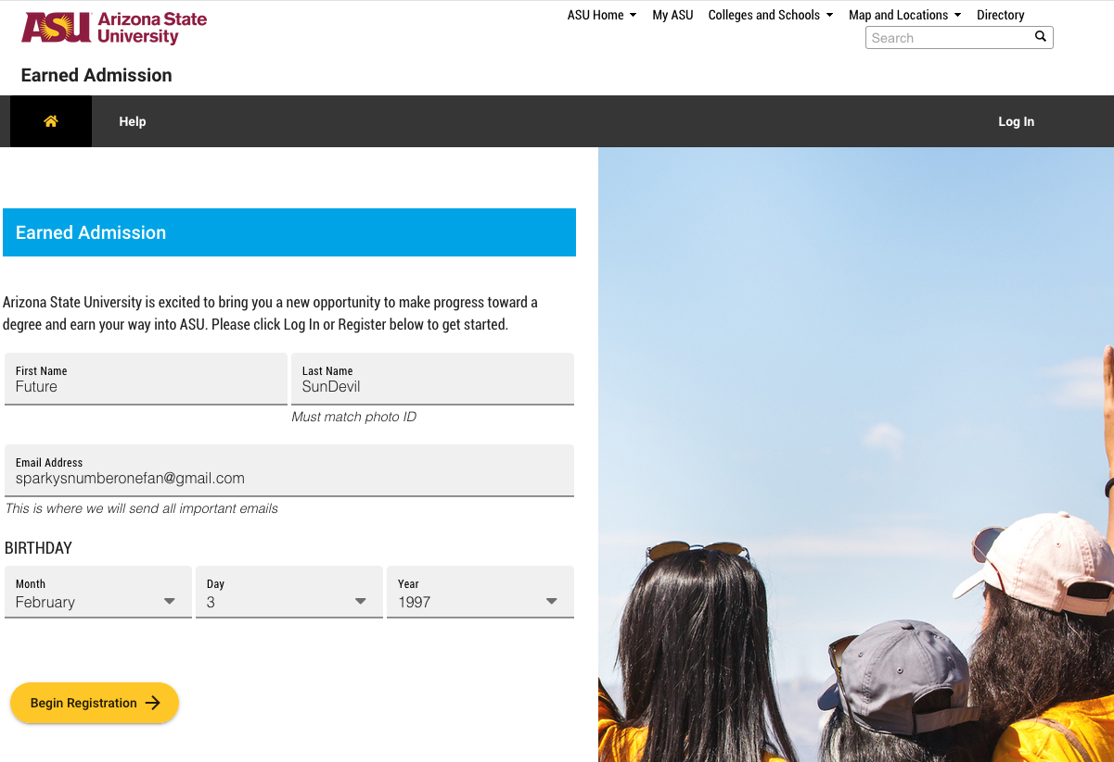
Kupu Pathways Registration Process
Once you click on Register on the Web Application page, you click on “Register”
If you already have an ASURite, then you will be caught by a “Traffic Cop” that will recognize your email and date of birth in the fields to the left and redirected to Login with their ASURite and password.
If you do not have an ASURite, you will need to complete this form so you can be issued an ASURite.
EdPlus

Slide 7
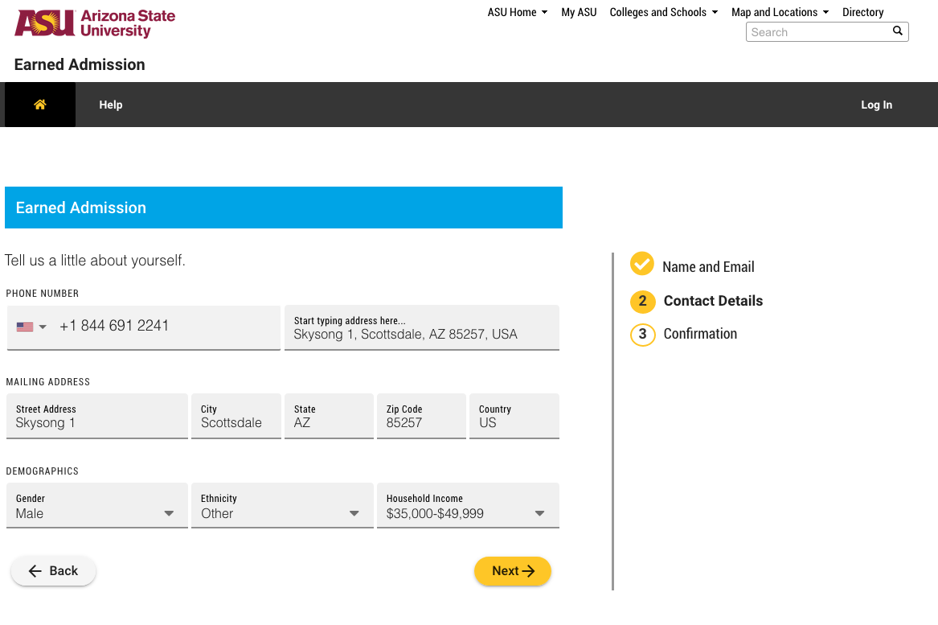
Kupu Pathways Registration Process
After providing your name and details, you will be prompted to submit your Contact Details.
The only field that is not required is the Household Income.
EdPlus

Slide 8
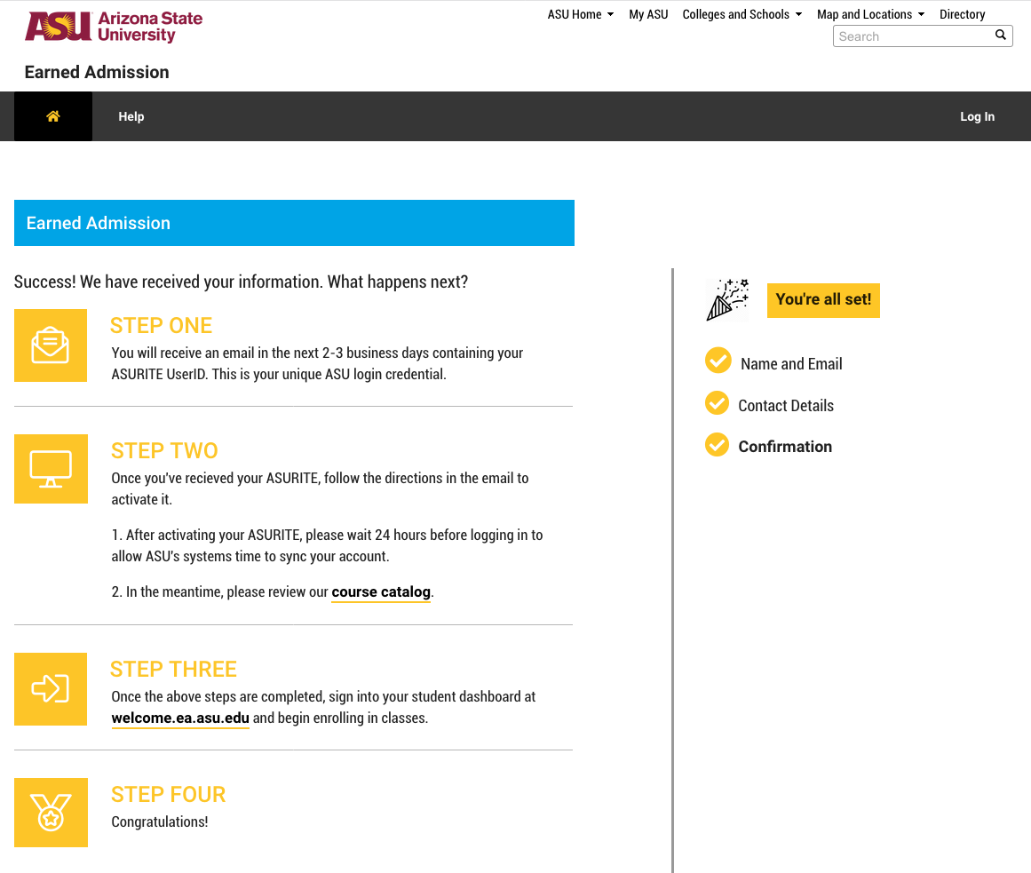
Kupu Pathways Registration Process
After submitting Contact Details.
You will be given a “Success!” page.
Should expect your new ASURite created and have sent an activation email within 72 hours.
It is important to know that once you activate your ASURite, it will take an additional 24 hours until you can log into your dashboard.
EdPlus

Slide 9
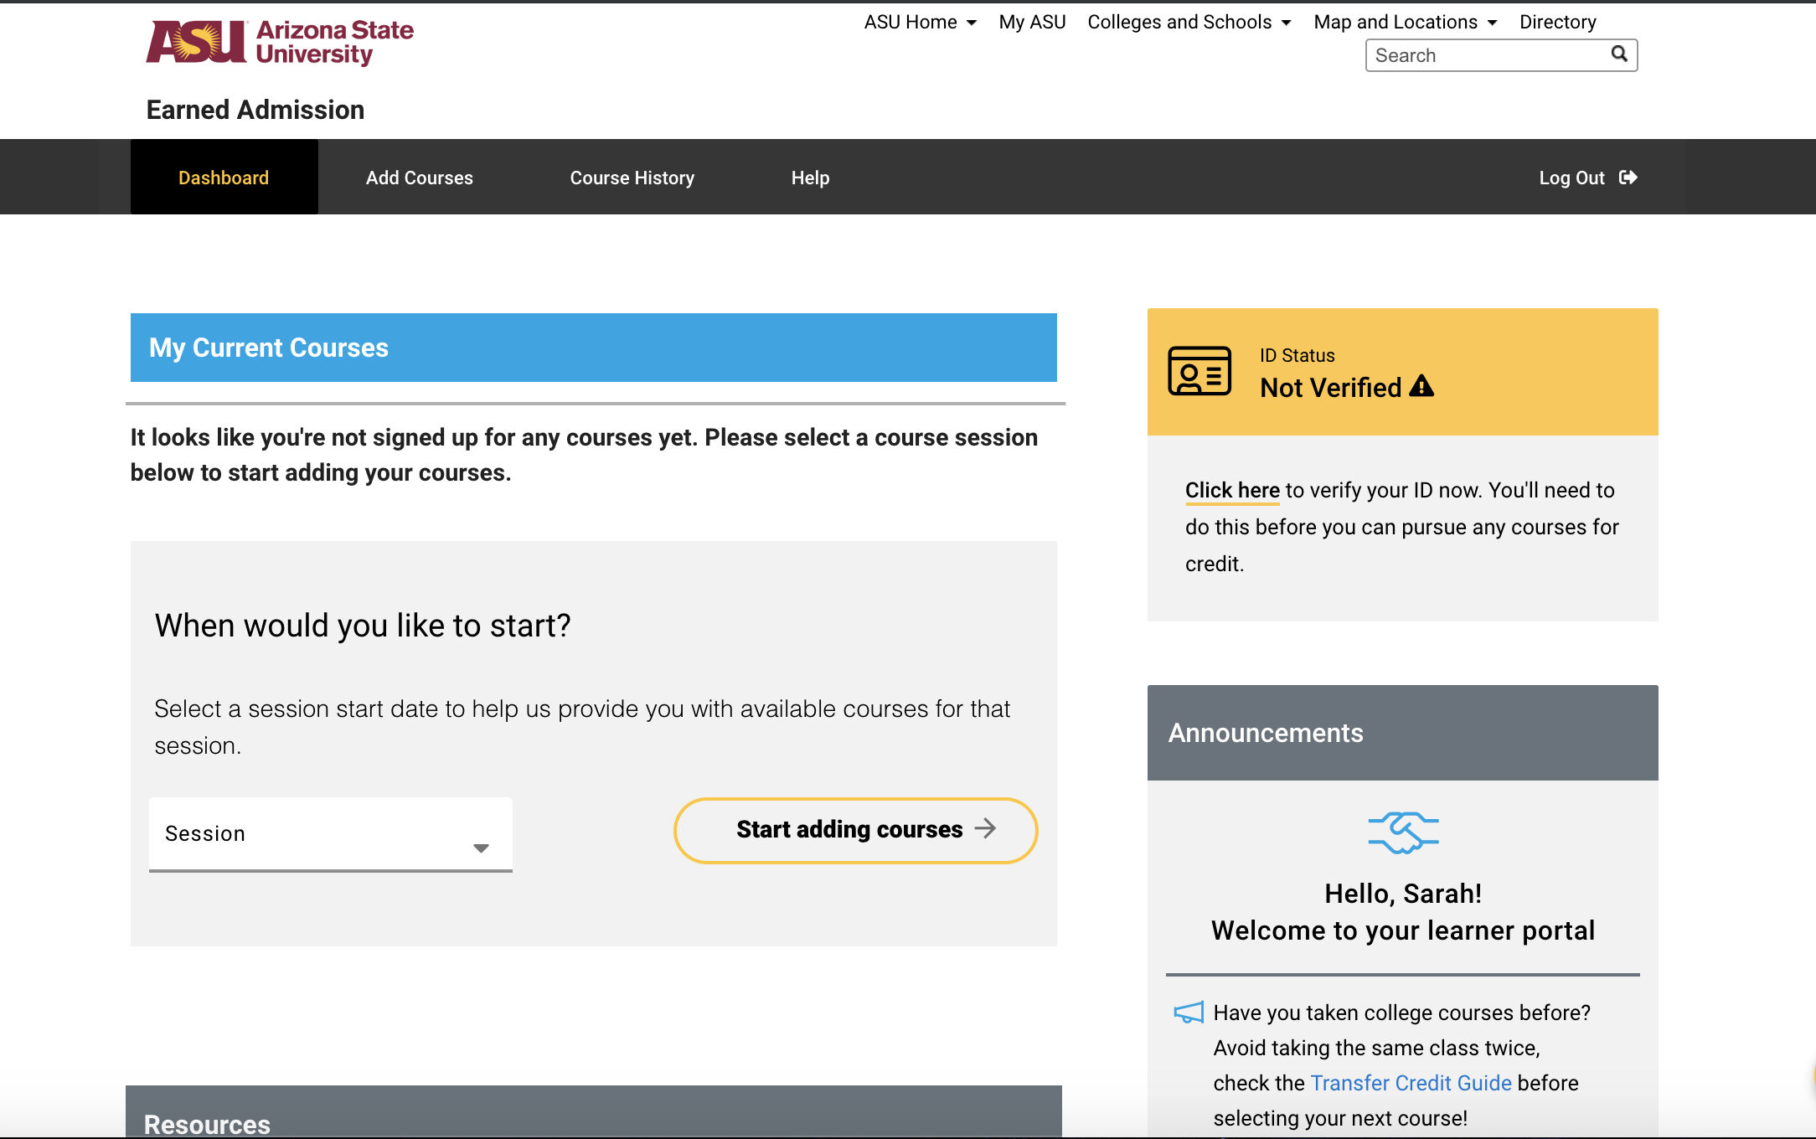
Kupu Pathways Course Selection
Once you activate ASURite and log in, this is your blank dashboard.
You can immediately start adding courses for multiple session start dates, verifying your ID, and utilizing the transfer credit guide to prevent any overlap in transfer credits.
All important Kupu Pathways announcements can be found here as well.
EdPlus

Slide 10
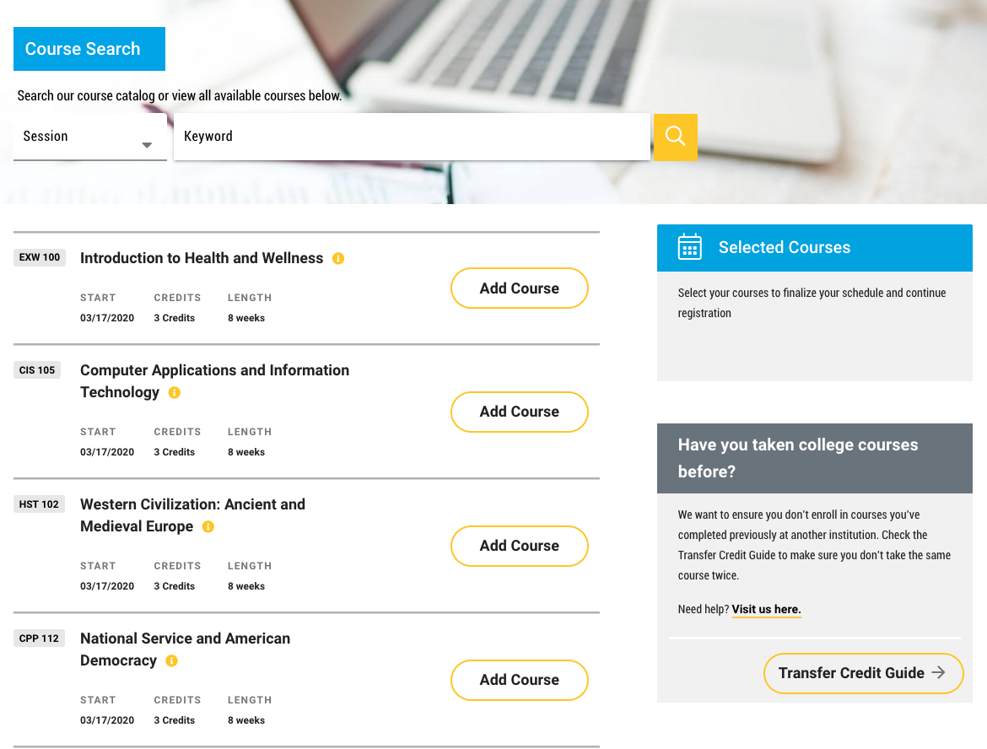
Kupu Pathways Course Selection
As soon as you click on “Start Adding Courses” you will be able to type in a ‘Keyword’ or use the ‘Session’ dropdown to limit which courses you can select.
We always encourage you to check your Transfer Credit Guide for any potential transfer course overlap.
EdPlus

Slide 11
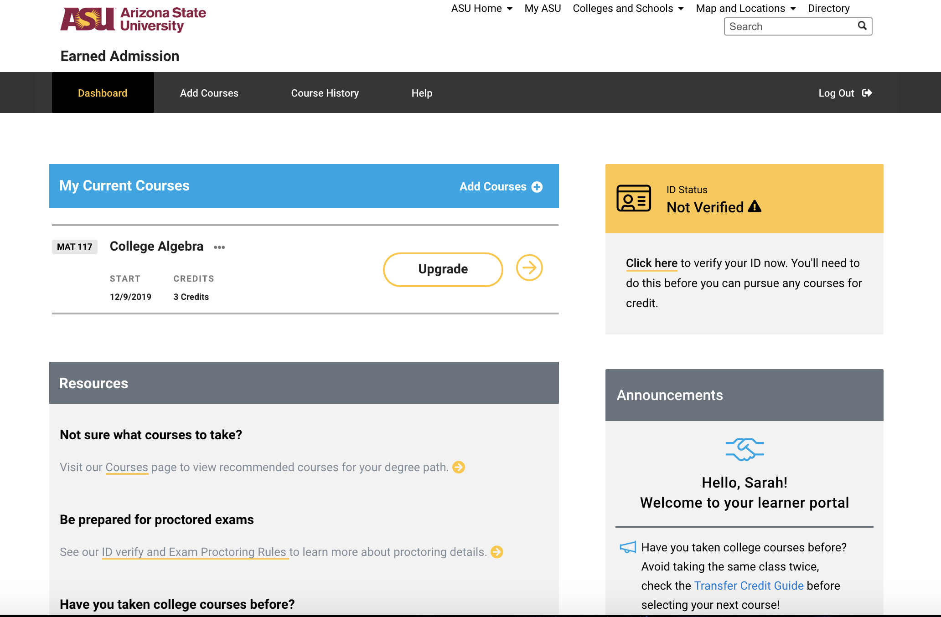
Kupu Pathways Upgrading to the Credit Eligible Track
In order to take any course for credit, you must:
  Pay the $25 fee through PayPal
  Complete ID verified (taking a picture of themselves and a picture of their government issued ID using their computer’s webcam)
EdPlus

Slide 12
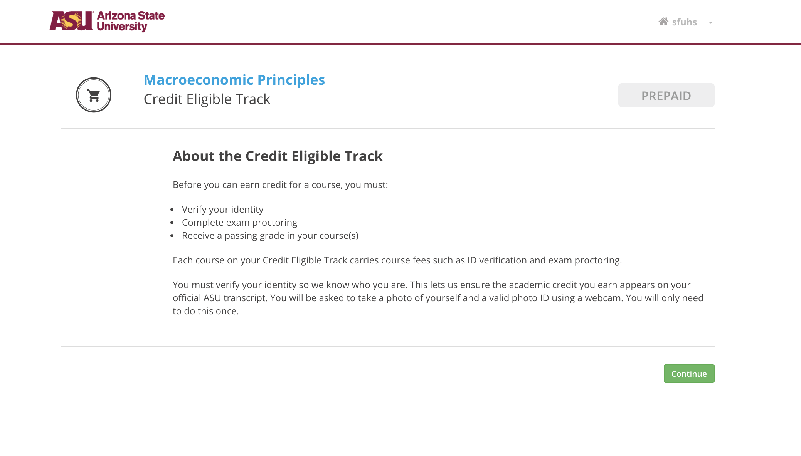
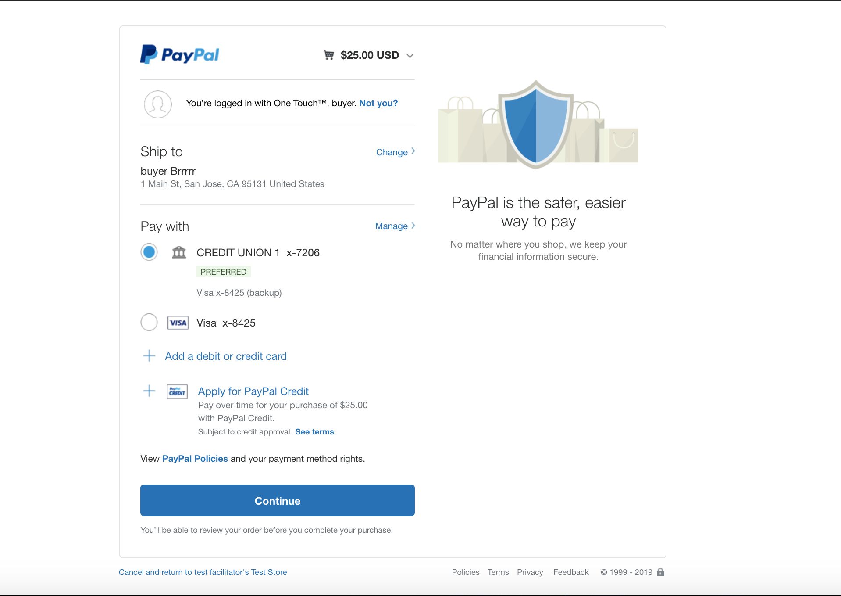
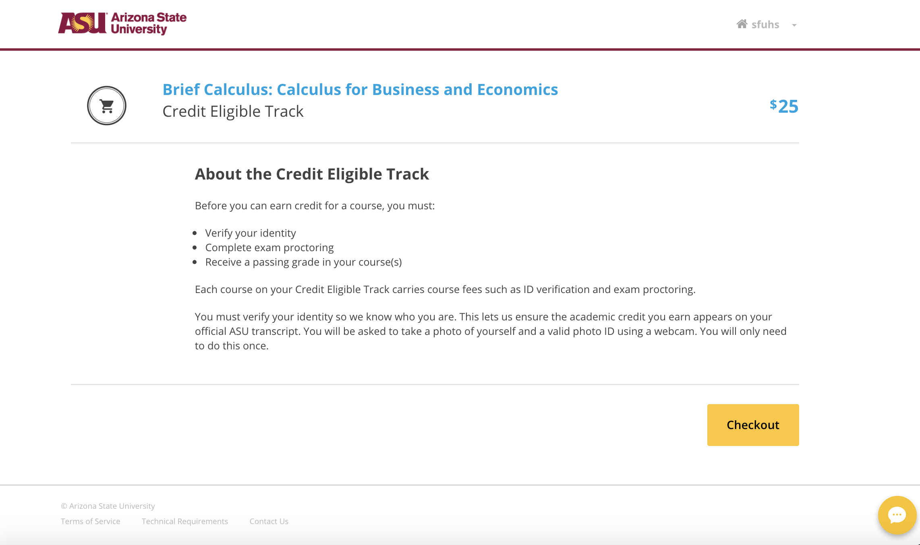
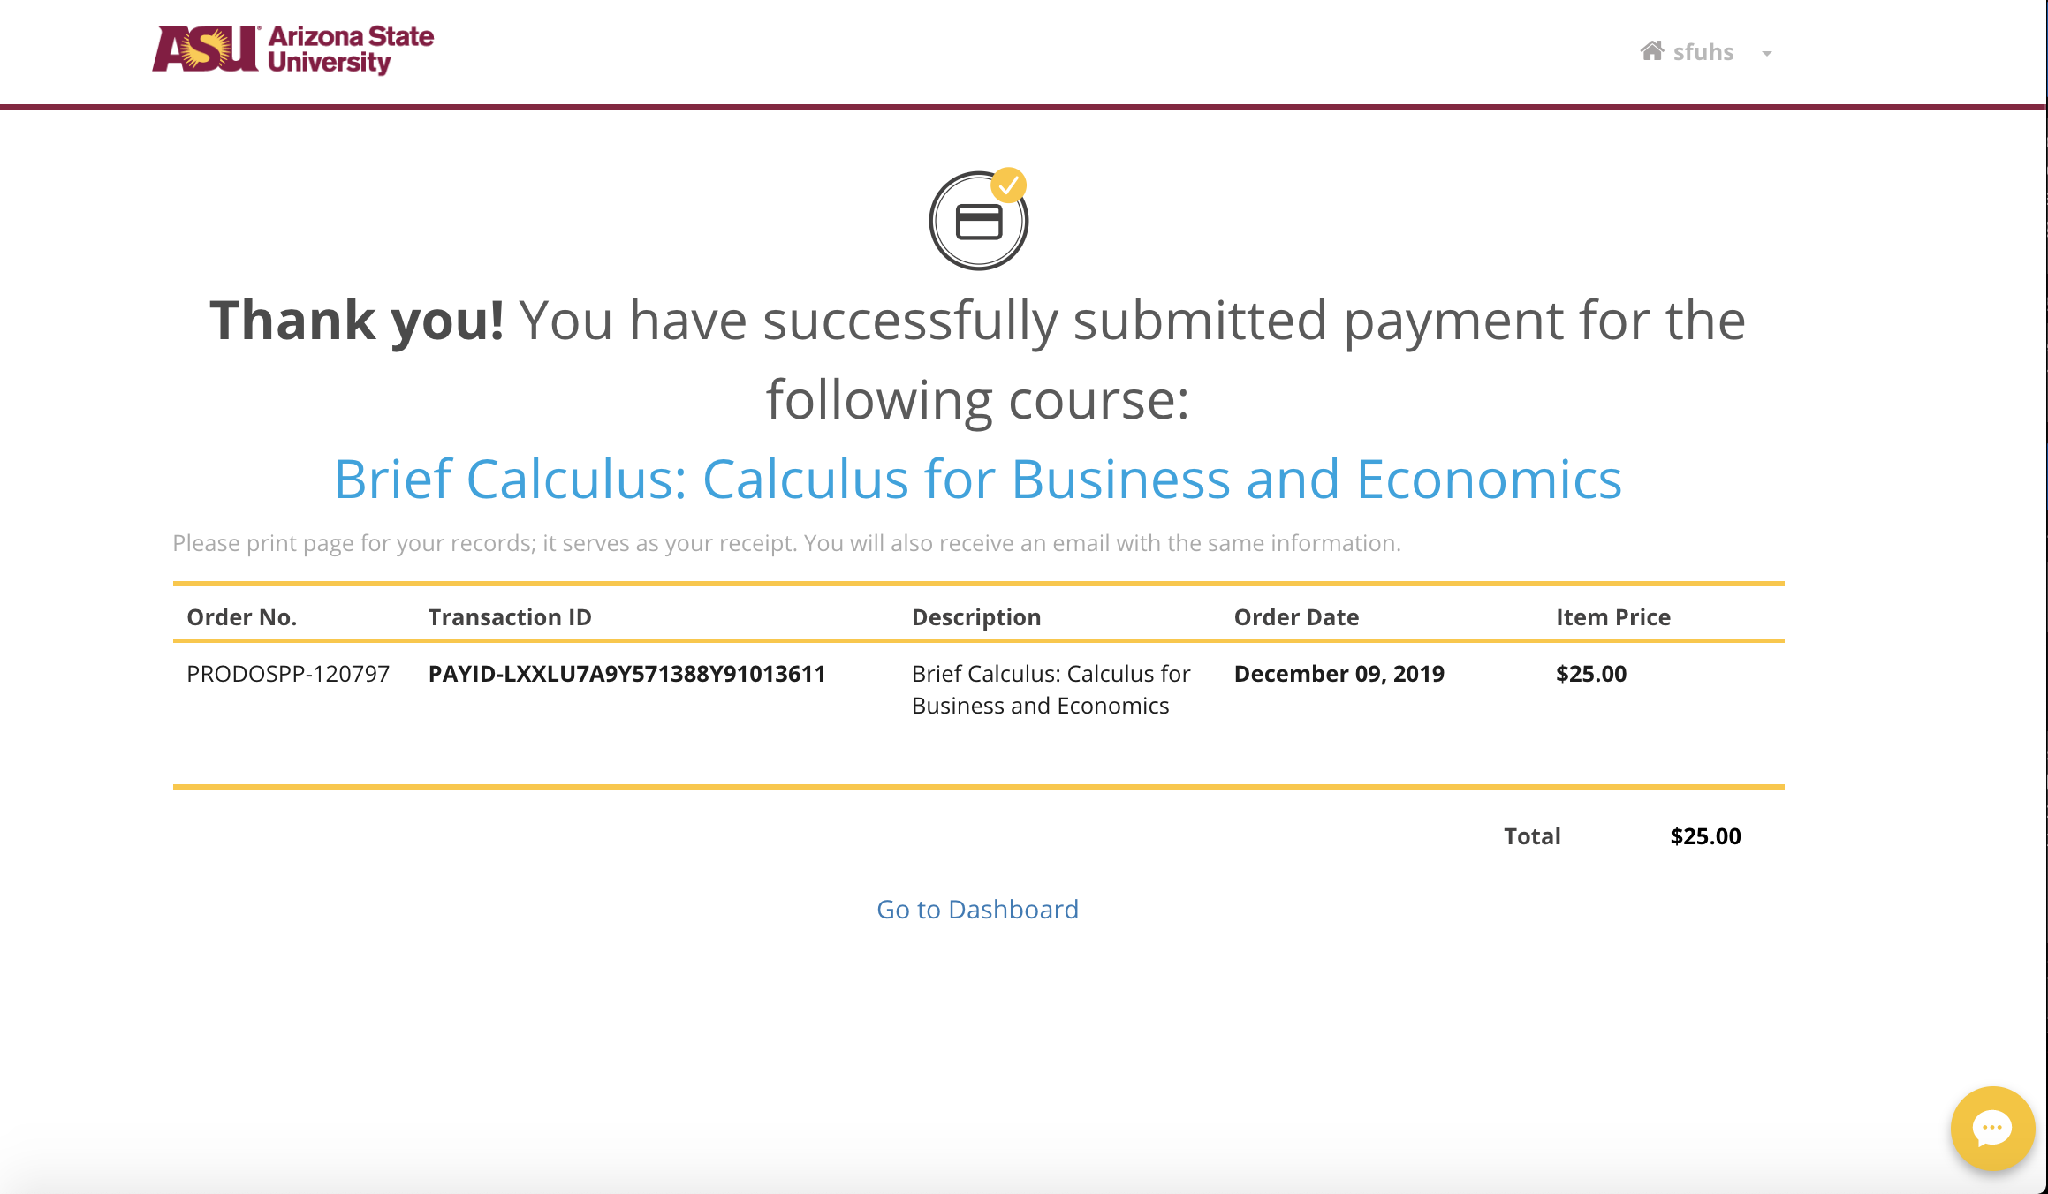
Process of Upgrading for Credit
Student clicked Pursue Credit
Click on “Upgrade.”
Redirected to PayPal where you can guest checkout to pay the $25
Clicks on “Checkout.”
Once the payment is made, you will receive a transaction ID number and you can return to dashboard.
EdPlus

Slide 13
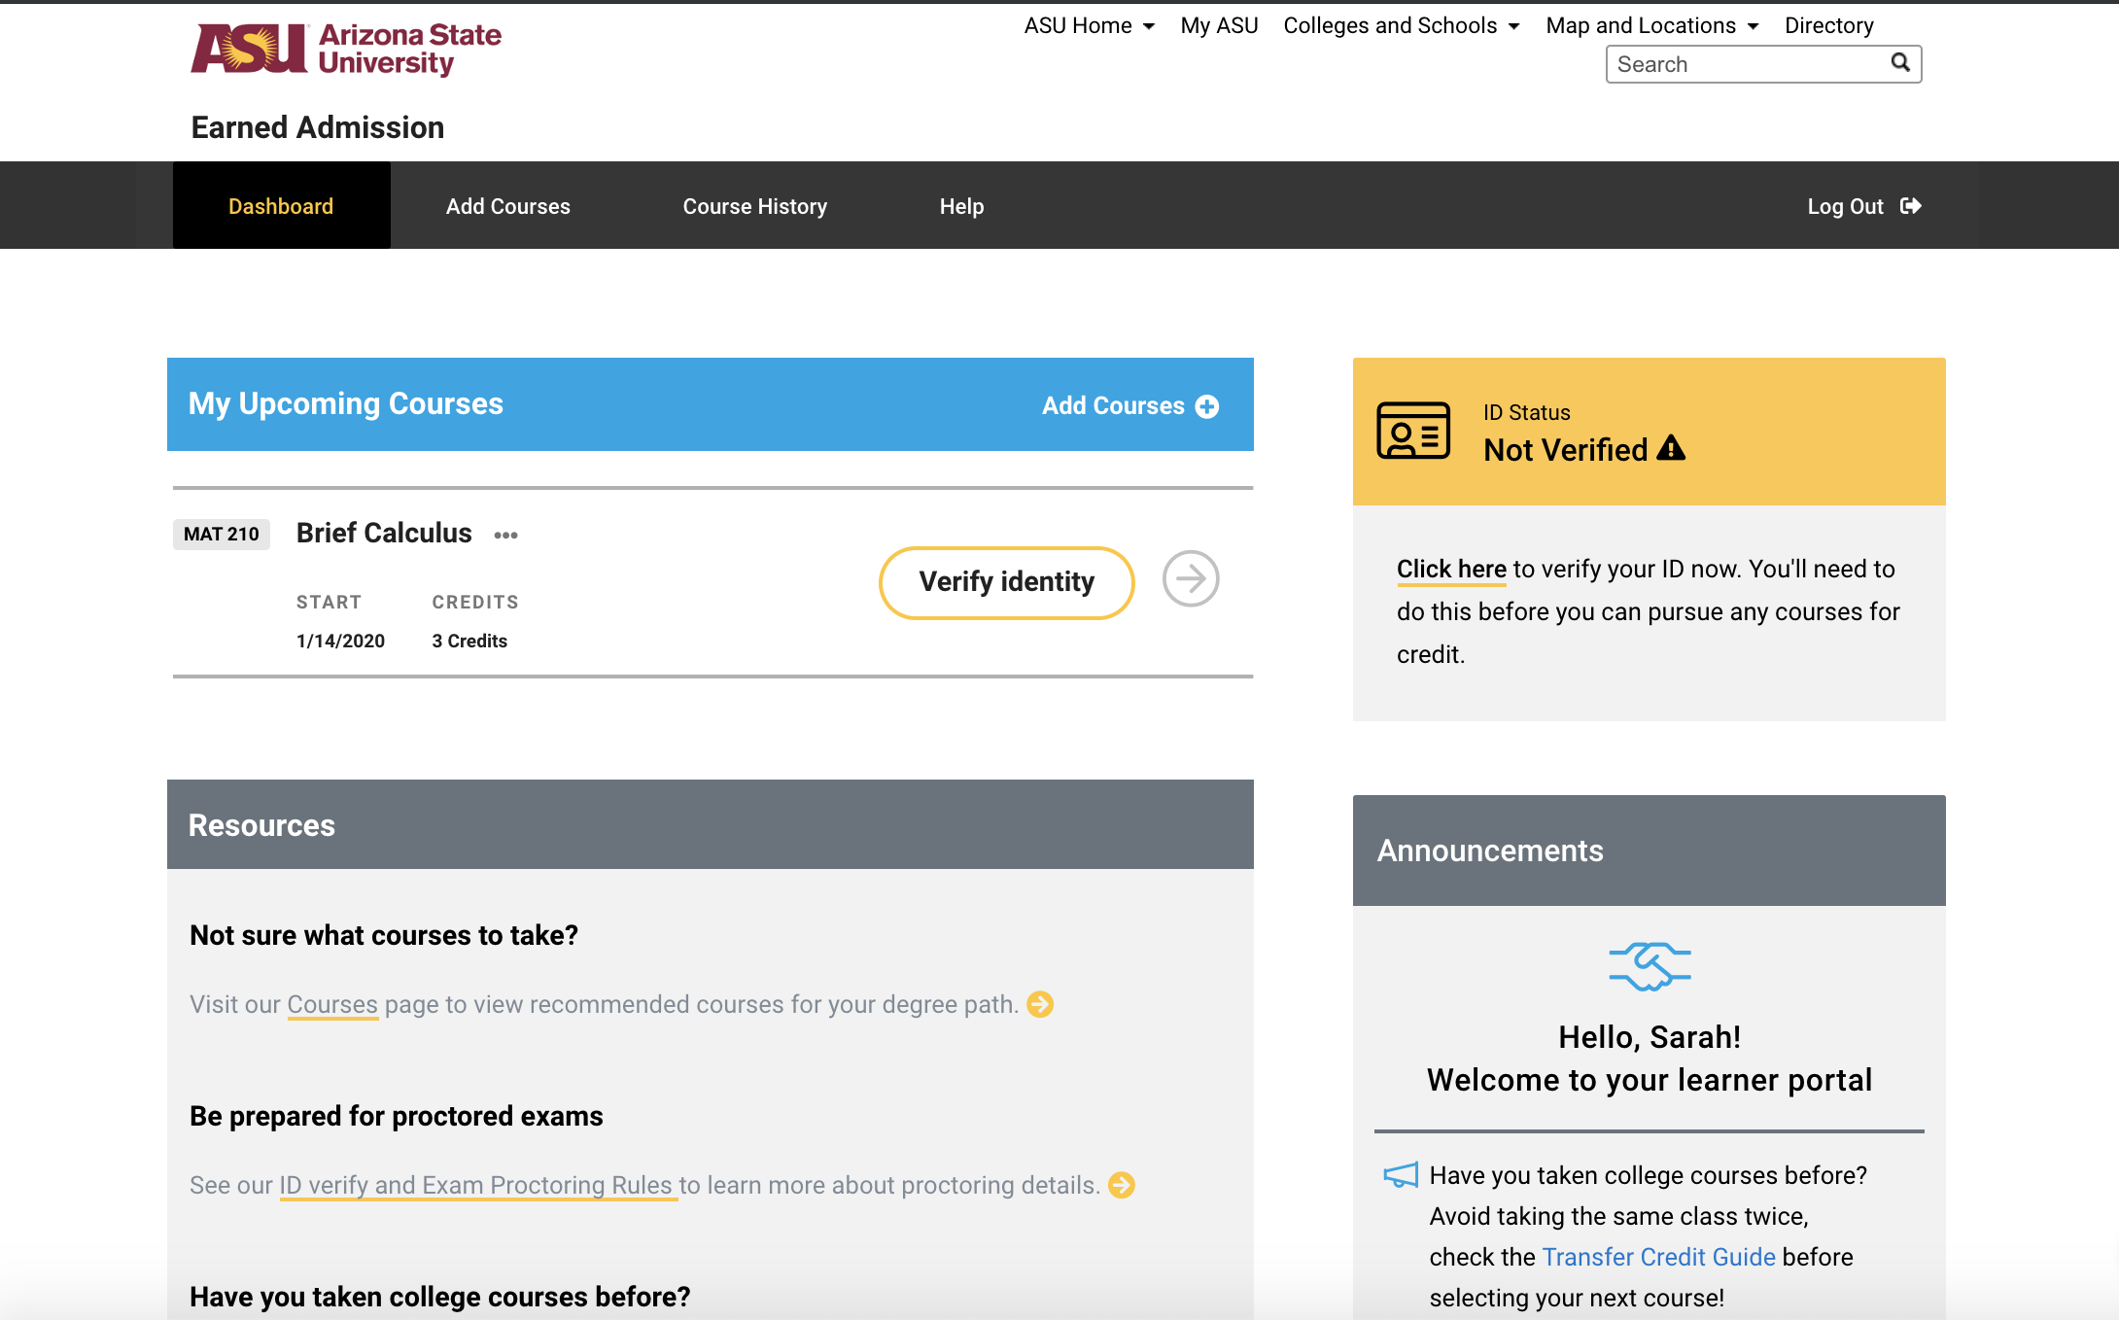
Process of Upgrading for Credit
Student clicked Pursue Credit
Once you complete Upgrading for credit, you must verify your identity by clicking on the “Verify Identity” button or the “Click here” link under the yellow ID Status box.
EdPlus

Slide 14
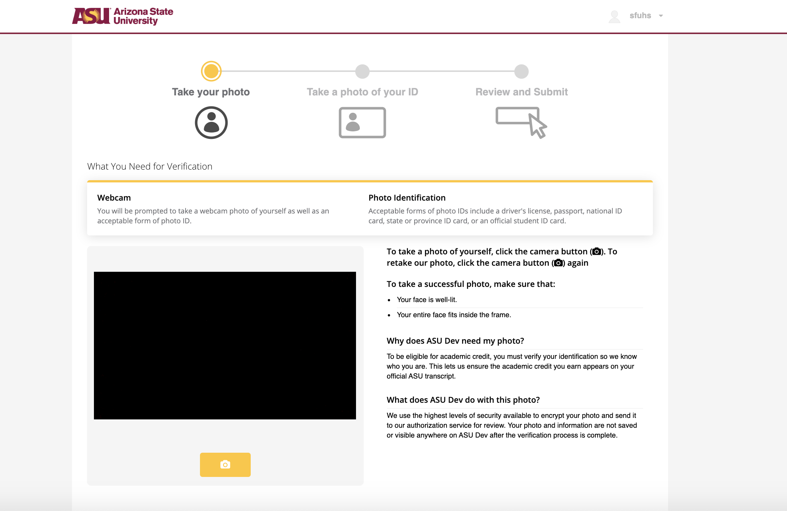
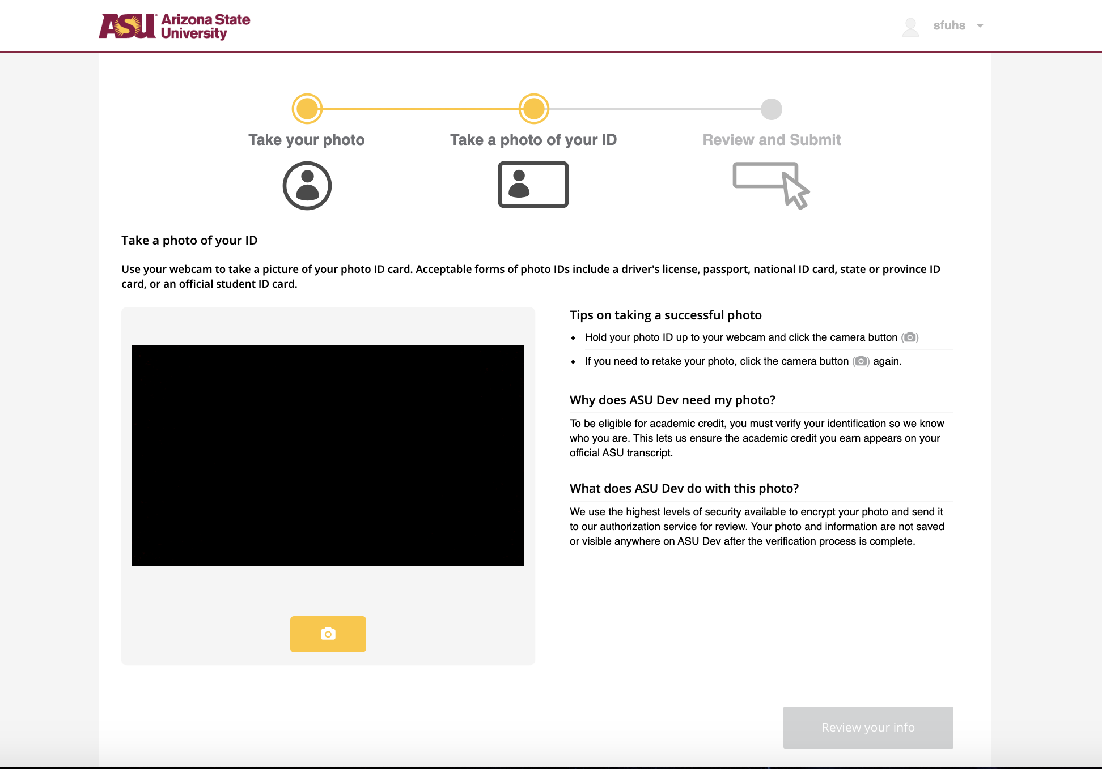

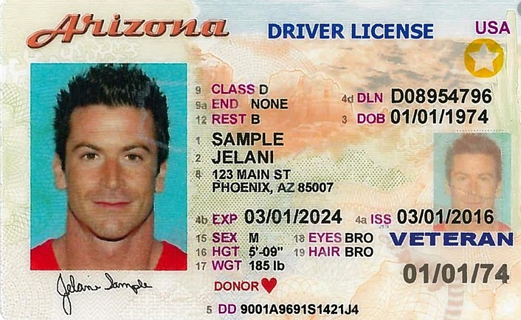
ID Verification Process
Student clicked Pursue Credit
As soon as you press “Verify Identity” you will be prompted to take a picture of yourself and a picture of your government issued identification card.
You will first take a picture of yourself.
You will then take a picture of your ID and click on ‘Review your Info.’
We recommend you complete ID verification on a computer with a webcam. This process is not compatible with mobile devices (i.e. smartphones, tablets, or Chromebooks)
EdPlus

Slide 15
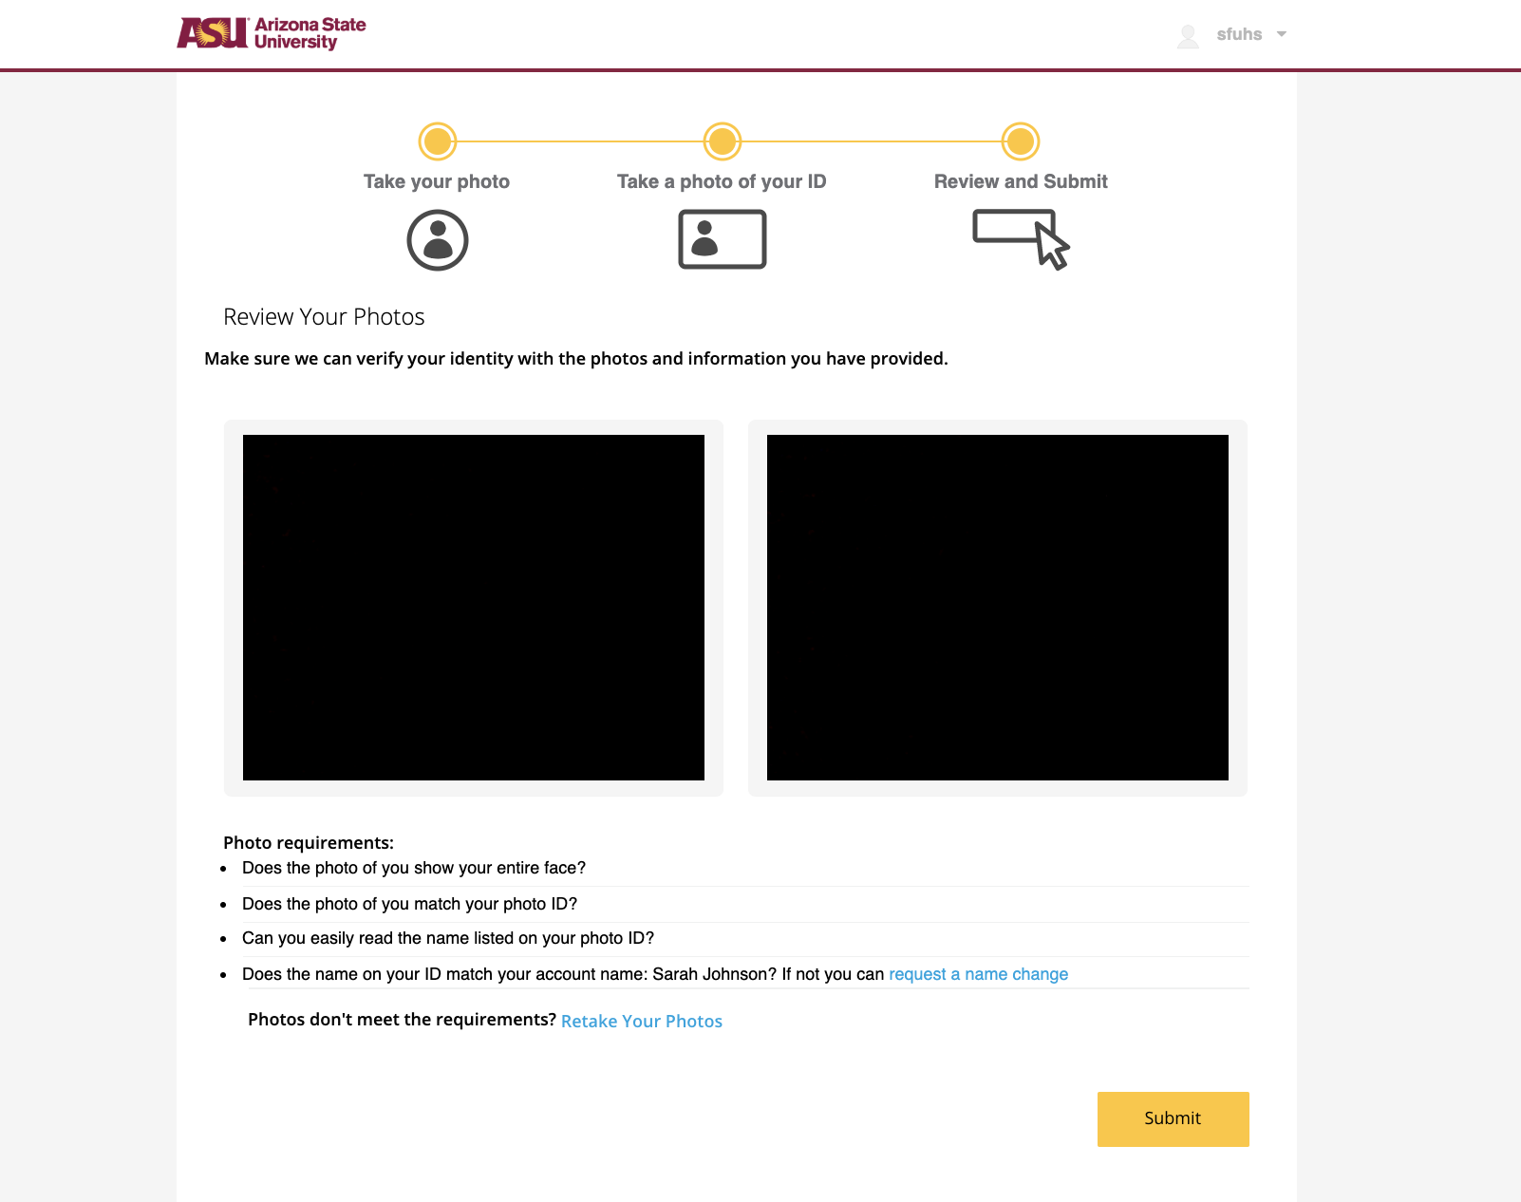
ID Verification Process
Student clicked Pursue Credit
You will confirm the two photos you have taken.
You must ensure that you are:
  Clear and eligible
  Your ID must match what is in ASU’s systems.
If you do not feel like these are good pictures, you can retake them before submitting them.
If you believe they are quality photos, then you can submit those pictures.
EdPlus

Slide 16
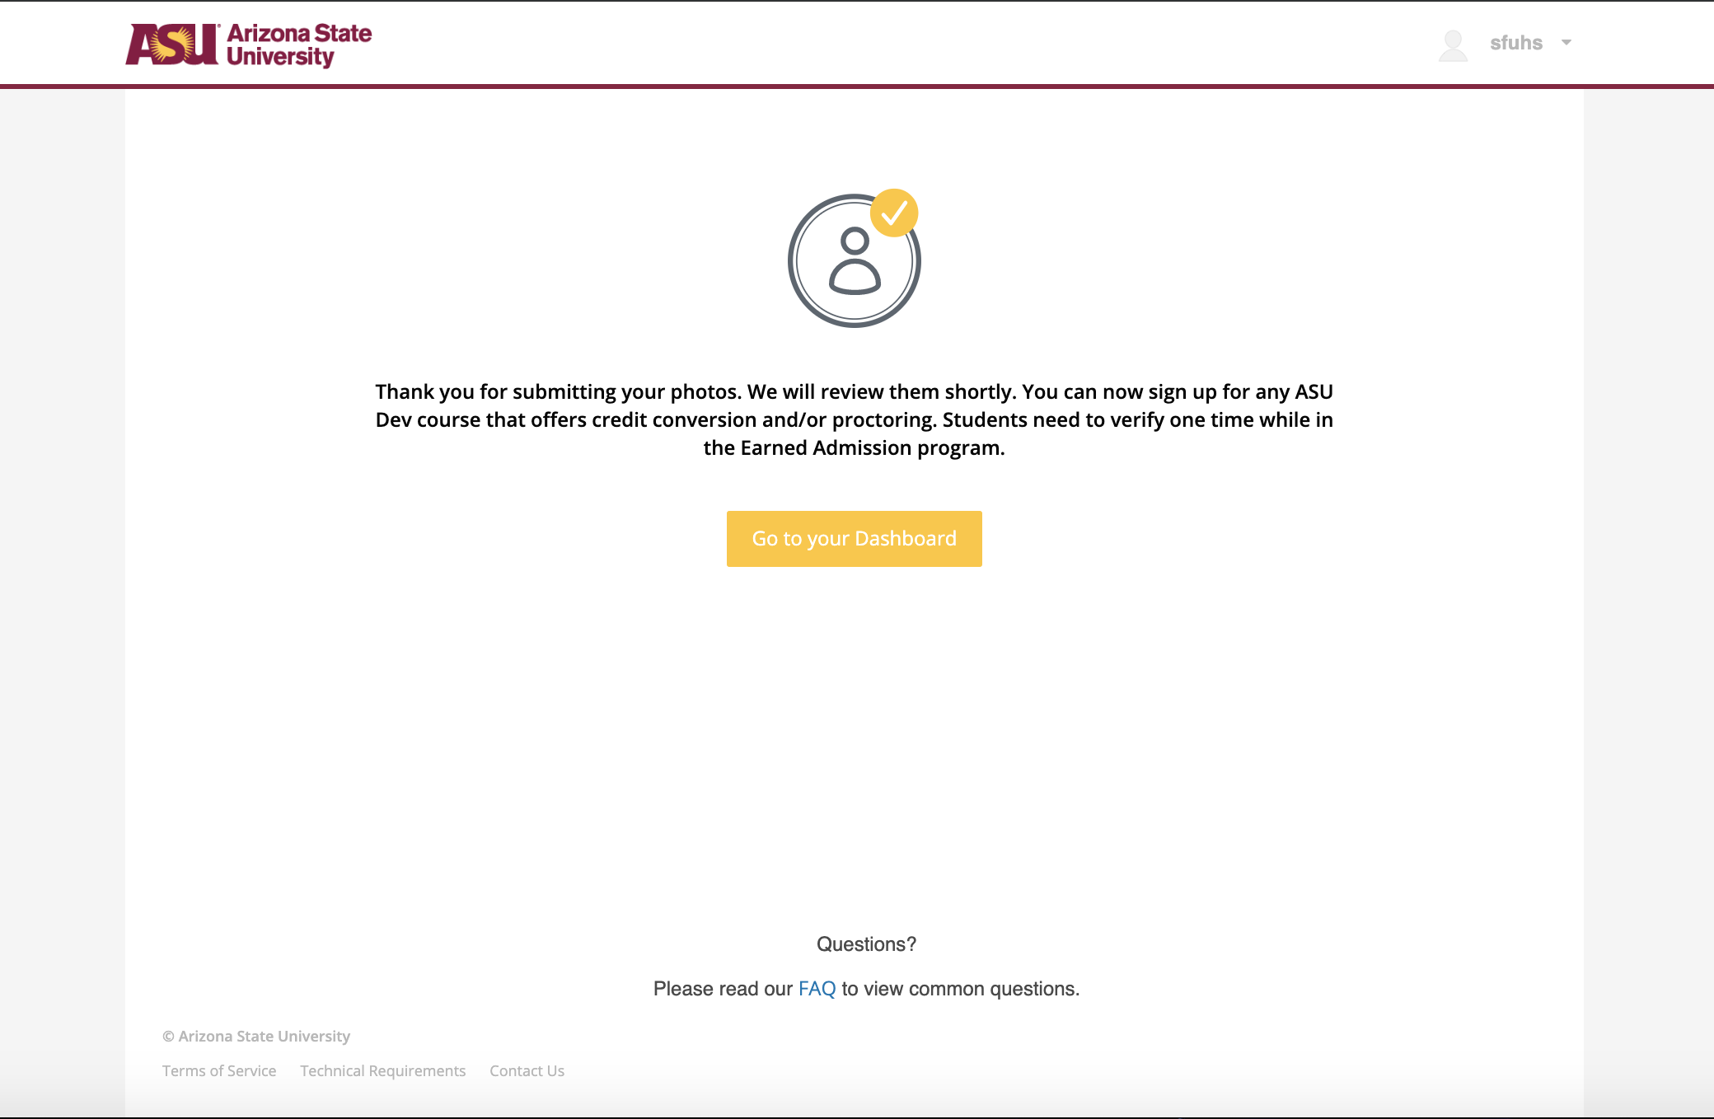
ID Verification Process
Student clicked Pursue Credit
You will confirm the two photos you have taken.
You must ensure that you are:
  Clear and eligible
  Your ID must match what is in ASU’s systems.
If you do not feel like these are good pictures, you can retake them before submitting them.
If you believe they are quality photos, then you can submit those pictures.
EdPlus

Slide 17
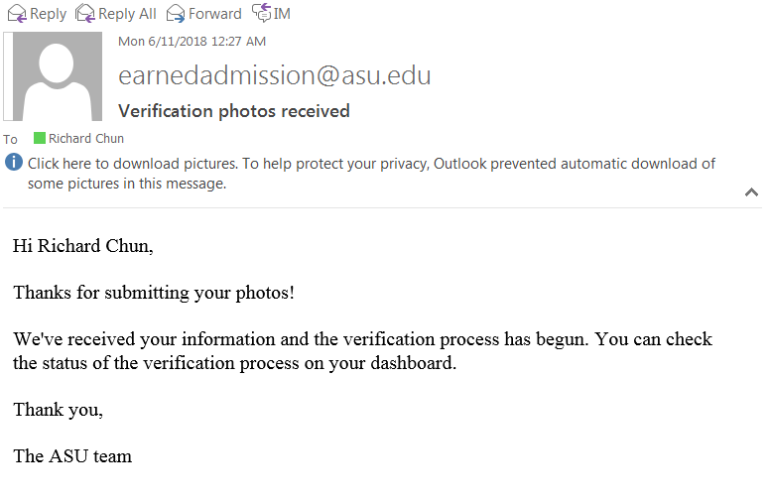
Verification: Email Confirmation
You will receive an email informing you that your ID verification review has started.
EdPlus

Slide 18
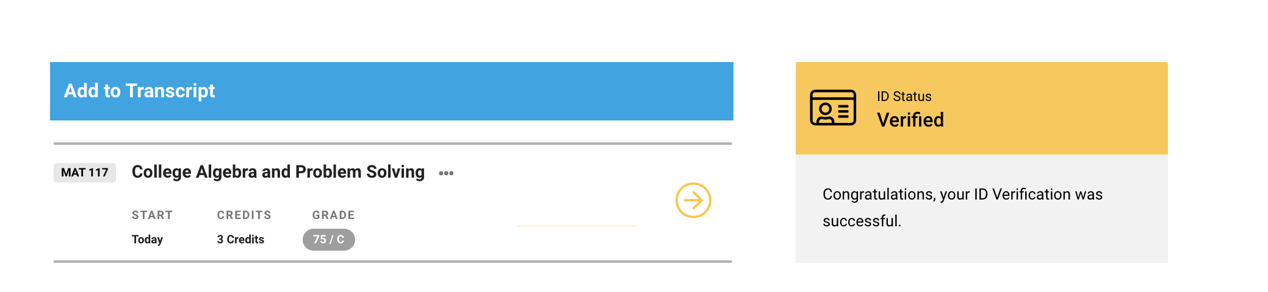
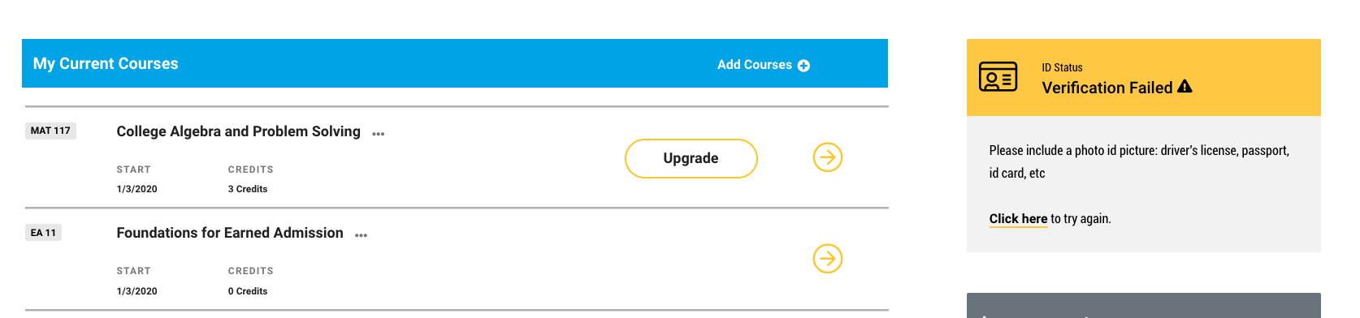
Dashboard after completing verification
Student clicked Pursue Credit
Example of a successful ID verification
Once completing verification, you can see your status on your dashboard.
If the status is “verified” that means the student completed verification successfully.
If the status is “denied,” you will be given an opportunity to redo ID verification with an explanation why your ID was denied.
It is important to complete verification before any proctored exams.
Example of an unsuccessful ID verification
EdPlus

Slide 19
Classes Available: ea.asu.edu/courses
Current Course Offerings
EA 11: Foundations for Earned Admission (self paced)
AST 111: Online Introduction to Astronomy (8 weeks; 4 credits)
BIO 100: Online Biology (15 weeks; 4 credits)
CHM 114: Online General Chemistry for Engineers (8 weeks; 4 credits)
CIS 105: Online Computer Science (8 weeks; 3 credits)
CIS 194: Online Business Technology Fundamentals (Self paced; 1 credit)
CIS 308: Online Excel in Business (8 weeks; 3 credits)
CIS 394: Online Location Analytics for Business (8 weeks; 3 credits)
CSE 110: Online Introduction to Programming (15 weeks; 3 credits)
FSE 100: Online Introduction to Engineering (15 weeks; 2 credits)
FSE 150: Online Engineering Grand Challenges (8 weeks; 3 credits)
MAT 117: Online College Algebra (15 weeks/self-paced; 3 credits)
SOC 101: Online Introduction to Sociology (8 weeks; 3 credits)
SST 220: Online Introduction to Social Transformation (8 weeks; 3 credits)
ECN 211: Online Macroeconomics (8 weeks; 3 credits)
MAT 170: Online Precalculus (15 weeks/self-paced; 3 credits)
MAT 210: Online Business Calculus (15 weeks/self-paced; 3 credits)
MAT 265 Online Calculus for Engineers (15 weeks/self-paced; 3 credits)
SES 106: Online Earth and Space Science (15 weeks; 4 credits)
EdPlus
Notes:
19 classes

Slide 20
Professor-Instructed Classes Available: ea.asu.edu/courses
Current Course Offerings
PSY 101: Online Introduction to Psychology (3/15/22 start date; 8 weeks; 3 credits)
ENG 102: Online English Composition II (3/15/22 start date; 8 weeks; 3 credits)
ENG 101: Online English Composition (3/15/22 start date; 8 weeks/self paced; 3 credits)
ECN 212: Online Principles of Microeconomics (3/15/22 start date; 8 weeks; 3 credits)
COM 100: Online Introduction to Communication (6/7/22 start date; 8 weeks; 3 credits)
MAT 142: Online College Mathematics (3/15/22 start date; 8 weeks; 3 credits)
HEP 100: Online Introduction to Health (3/15/22 start date; 8 weeks; 3 credits)
ACC 231: Online Accounting for Business (3/15/22 start date; 8 weeks; 3 credits)
ASM 246: Online Paleoanthropology (3/15/22 start date; 8 weeks; 3 credits)
CEE 181: Online Sustainable Engineering (3/15/22 start date; 8 weeks; 3 credits)
CIS 310: Online Business Data Visualization (3/15/22 start date; 8 weeks; 3 credits)
CIS 309: Online Business Process Management (3/15/22 start date; 8 weeks; 3 credits)
PAF 112: Online Civic Engagement (3/15/22 start date; 8 weeks; 3 credits)
HST 102: Online History (3/15/22 start date; 8 weeks; 3 credits)
EdPlus
Notes:
19 classes

Slide 21
Cost
$25.00 - Eligibility Fee to register per course (Application Fee)
$400.00 - Purchase credits for completed classes that you are happy with the final grade, this will then be added to your academic transcript
EdPlus

Slide 22
Student Frequently Asked Questions
EdPlus

Slide 23
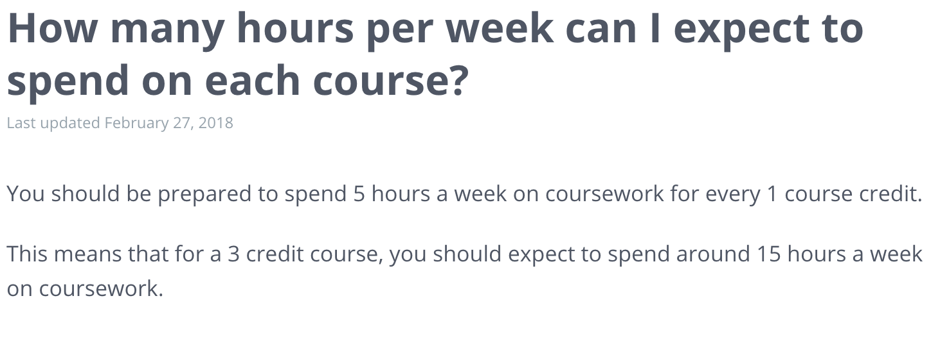
Frequently Asked Questions
EdPlus
Notes:
6 hours a week - 18 hours per 3 credit course per ABOR requirements

Slide 24
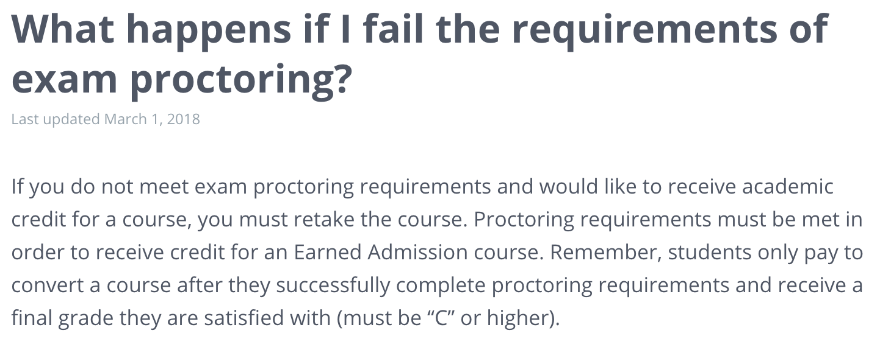
Frequently Asked Questions
EdPlus

Slide 25
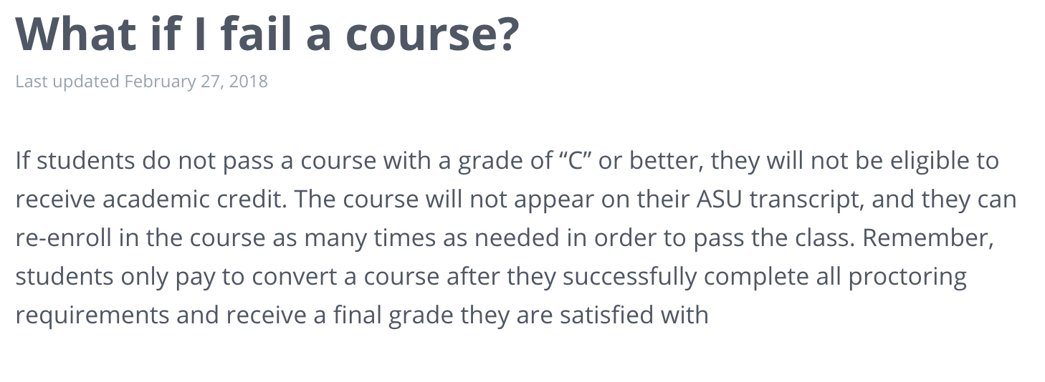
Frequently Asked Questions
EdPlus

Slide 26
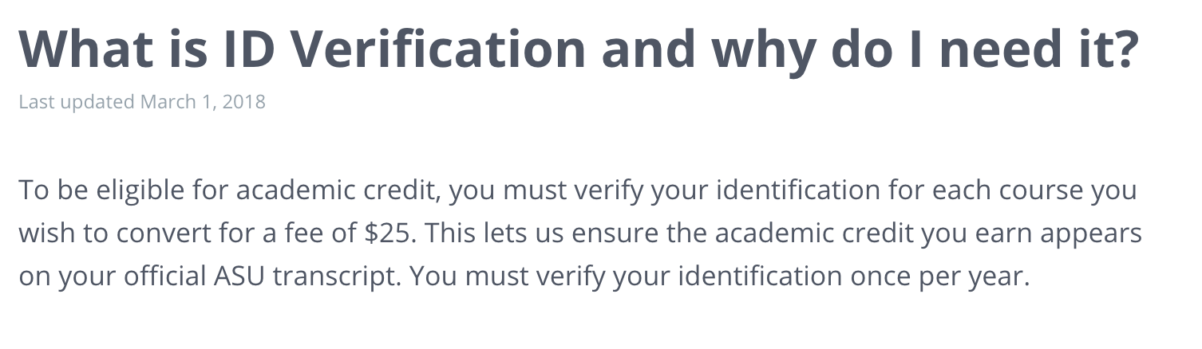
Frequently Asked Questions
EdPlus

Slide 27
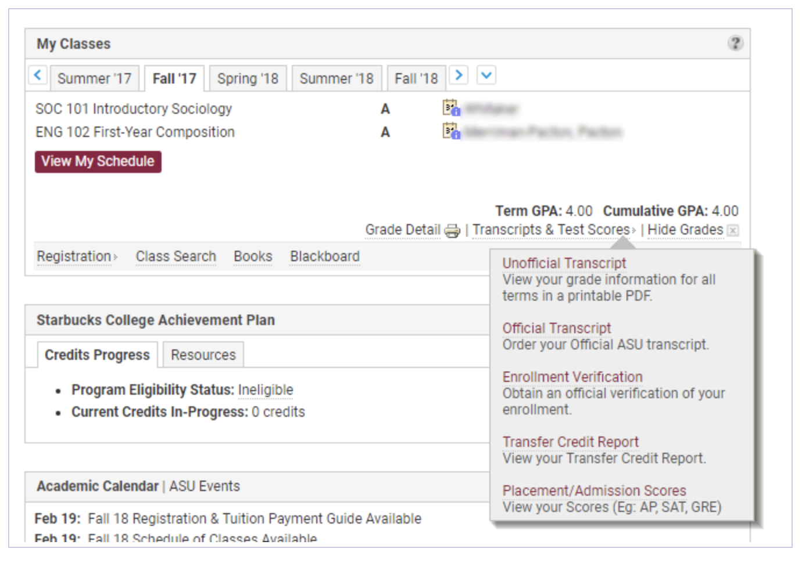

Slide 28
Continuing and Professional Education
Dedicated to improving the skills and talent of working professionals and lifelong learners, through high-quality courses that expand opportunity, fulfill passions and positively impact the future of individuals, organizations and businesses.
Ideal for those who have completed a bachelor's degree
Easy to show off, resume-ready badges and certificates when you complete a course
Varies in price
cpe.asu.edu
EdPlus
Notes:
Beyond Kupu Pathways- available to all. Use your Segal Education Award for non-credit courses through Continuing and Professional Education at ASU. These online classes are non-credit bearing. However, students will receive a certificate and digital badge upon completion of their courses, which can help you improve your resume and compete for jobs in your market. Earn a certificate and digital badge for completing classes in professional speaking, management training, project management and more. Discounted rate.
Once they submit the form found on this page (https://cpe.asu.edu/americorps-benefit)

Slide 29
Helpful Links and Contact Info
  Kupu Pathways
  Web App: https://kupu.ea.asu.edu
  Email: earned@asu.edu
  ASU Phone: 844-691-2241
Continuing Professional Education:
cpe.asu.edu
cpe.asu.edu/americorps-benefit
Raven Gates: raven.gates@asu.edu
Hours of Operation
  7AM to 6PM AZ Time, M-F
  24 hour turnaround time
  Email, phone, chat
EdPlus

Slide 30


Questions?
EdPlus

